Slide 1
Code Contracts: Usage, Value, and Future
Brian Grunkemeyer
April 22nd, 2010

Slide 2
Agenda
Where are we now?
Dev10 Customers & Feedback
Dev 11 Roadmap
Tools – ownership and future
.NET Framework adoption
Solving problems for DevDiv
Asks
Tool ship vehicle
More Depth in libraries & tools

Slide 3
What are Code Contracts?
Expressing correct, intended behavior of code
Preconditions for a method’s callers
Postconditions for a method’s return value
Invariants for objects
Specifications live in code
Helps development, testing, and documentation
Contracts find problems in two ways:
Runtime checking – Asserts on steroids
Static checking – Finds bugs at build time
Notes:
Revisit first line
Monetization?
Next slides: What we shipped in Dev10
Backup slides for most of the details

Slide 4
Brief Example
Preconditions describing caller’s obligations
Different forms for performance, compatibility & risk mitigation
Postconditions specifying return values & side effects
Other features not shown: invariants, quantifiers, etc.
public sealed class String {
public String ToUpper(CultureInfo culture) {
Requires.NotNull(culture, “culture”);
Contract.Ensures(Contract.Result<String>() != null);
return culture.TextInfo.ToUpper(this);
}
[ContractArgumentValidator]
static void NotNull(object argument, string name) {
if (culture==null) throw new ArgumentNullException("culture“, …);
Contract.EndContractBlock();
}

Slide 5
Why Code Contracts?
End users win:
Better quality software
Developers win:
Find more bugs faster => saves time & money
More rigorous developer mindset => better quality software
Documentation covers some API behavior
.NET Framework wins:
Behavioral contracts on API’s => FX Compat across code bases & versions
Building block for future platform innovations
Feature parity with competition (ie, Java Modeling Language)
Microsoft wins:
Stronger .NET platform & more compelling Visual Studio testing offerings
Static checking only available for VS Premium users [ $? ]
Notes:
This is a division-wide idea.

Slide 6
Contracts in Dev10 and Silverlight
.NET FX 4 and Silverlight 4 include Contract class & related types
Code Contract tools
4 tools with samples & documentation
Shipping on DevLabs & MS Research
Static checker limited to our VS Premium customers
Increases the value of other test tools
Pex (a VS Power Tool) gives you good code coverage, but knows nothing about correctness. Contracts fill in the correctness part.

Slide 7
Dev 10 Adoption
Downloaded from DevLabs by 15,200 customers
Feb 2009 to end of Feb 2010
60% were VS Premium downloads, 40% standard
Downloaded from MS Research 6,500 times
Microsoft Partners
Optic team (Chris Martinez)
Patterns & Practices Team
Pex (Testing tool to improve code coverage)
Andrew Arnott’s DotNetOpenAuth tool
Midori
Notes:
Note: Tools are available both on DevLabs and on the Microsoft Research site for Code Contracts (http://research.microsoft.com/en-us/projects/contracts/).
The MS Research site shows up first if you do a Bing search or Google for Code Contracts. The DevLabs site is #2.
Wikipedia article on Design By Contract points at the MSR site too.
From Mike on Patterns & Practices team:
They are marking up their existing validation methods with enough information (i.e., custom attributes and Contract.EndContractBlock markers) so that our tools see the calls to their validator methods as contracts. They will then ship their sources to their customers who can independently download our tools in order to use them on the code.
--
They ship source (and only source) to their customers. Their sources contain a static class with methods like “RequiresIsNotNull” (not sure of the exact name). We’re testing out our new validator support on their code to see how easy we can make it for an existing codebase to adopt contracts. I believe we have modified just one of their samples, but it is their current sample for Sharepoint. My understanding is that they work on just one sample at a time --- whatever is hot at the moment.

Slide 8
Press & Blog Coverage
Blogs
CodeContracts.info taken by an enthusiastic software tester
Code Contracts Enhance Quality and Testability of Legacy Code
#3 on “Ten Features in .NET 4.0 That Made Me Smile”
Static checker gets some warm reviews as well
“Even more amazing is that the static checker sometimes makes suggestions as to what pre-conditions I should include! So the static checker is really helping to make my code more robust.”
Code Contracts – suppressing warnings
Books
CLR via C#, Jeffrey Richter
C# In Depth, Jon Skeet
C# in a Nutshell, Joe Albahari
Introducing .NET 4 with Visual Studio 2010, Alex Mackey
Potential for academic adoption: Bertrand Meyer may rewrite his intro to programming book in C# if/when contracts become truly first class
Code Contracts & Pex PDC talk was the 8th best ranked talk in 2009. They were #1 in 2008.
Notes:
The flow on this slide should be that we’re building a community. Don’t delve too much into the details.
Blogs:
Press/blog coverage
Positive
"Brilliant new feature" but no other mention: http://blogs.msdn.com/davethompson/archive/2009/12/14/dynamic-xml-reader-with-c-and-net-4-0.aspx
Listed as #3 in "Ten Features in .NET 4.0 That Made Me Smile": http://www.develop.com/tenfeaturesdotnet4
Anecdote about using contracts (with logging) to cut down the time to diagnose an error from 20-40 minutes to 5 minutes: http://blog.dallen.info/?p=18
A programmer's decades-long experience with various design-by-contract systems: http://blog.dallen.info/?p=14
8th-ranked session at 2009 PDC, with mostly positive comments ("I intend to use contracts in my organisation[sic]."), but a few skeptical ones ("The goals of these prototypes sound good, but if it looks like code but doesn't run like code, it's an error waiting to happen.")
Assessment of the feedback given to someone giving a talk on Stubs/Moles in the Belgium user group. Included a few requests for more support for contracts (shipping in the box, etc.)
Bug report mail that mentions that it's good not just for finding bugs, but also for helping improve the structure of the code.
Forum post summarizing blog that says contracts can enhance quality and testability of legacy code.
Blog post that includes mention of a bug found and fixed, as well as details about suppressing warnings: http://robertmccarter.wordpress.com/2010/02/05/code-contracts/
Blog that devotes a lot of posts to code contracts: http://codecontracts.info/?blogsub=confirming#subscribe-blog
Forum Post: “Hello! I just started playing around with code contracts, and I have to say they're the coolest thing to happen to .NET since generics at least. I've been adding contract logic to my test library and it's already helped me find several bugs I've been overlooking for years.”
http://social.msdn.microsoft.com/Forums/en-US/codecontracts/thread/c405b5f6-b62b-422f-a96f-60cd660b0c8c
Found some places where he might be reference null, and caught them before deploying on Azure, which is apparently difficult to debug.
Bug found with contracts:
Dev10 715860
Low-priority bug discovered with contract inheritance from an interface. GenericAcl.SyncRoot was null.
Negative
"still shows a lot of initial promise" but contracts are "unusable in their current form". Includes several examples of missing functionality the author would like to see, and says the problems could be overcome: http://www.infoq.com/news/2009/12/Code-Contracts-Review
Blog post mentioning that they now use contracts, but cautions not to do everything the static analyzer suggests. Things I learned last week #2 - Peter's Software House
Team that decided not to use contracts in Tuvalu after reviewing cost/benefit and priorities (not much more detail than that).
<<FW No Code Contracts.msg>>
Request for the tools in VS
<<FW Code Contracts & VS 2010.msg>>
Neutral
Example of contract usage from the forums: someone uses it for ~150 assemblies in their build. This was as part of an error report for the static analyzer, though.
http://social.msdn.microsoft.com/Forums/en-US/codecontracts/thread/786eb2d0-6dd4-479e-9a96-2c3c781d0d50
Books the mention contracts (details from Amazon)
CLR via C#, Jeffrey Richter 20 (C# Rank)
C# in Depth, Jon Skeet 32 (C# rank)
C# in a Nutshell, Joe Albahari 23 (C# rank)
Introducing .NET 4 with Visual Studio 2010, Alex Mackey
C# Insiders Mails
* People looking forward to using them for non-null assertions, but doubting they'll be included in the languages:
* Discussion mentioning Code Contracts in terms of validation options. Brings up that it can only validate things known at compile time, but are still useful. Summary quote from Peter Ritchie "Contracts are good for *some* validation; but not all." [Forked thread, including multiple mails.]
* Contract ObjectInvariants helping to make it easier to use auto-properties in C#.
* Examples of where syntactic sugar would be handy (autoproperties, interfaces)
* Request to expose some level of rewriting to users.
* Requests for some more predicates around whether an object is disposed
Customer feedback on PDC presentation on Code Contracts & Pex:
The guys are really great. I like how they did the presentation and what they showed. Pex is crazy thing, I want this for C++ :)
A very engaging presentation. Both tools look very useful, and were presented very well.
I really liked the content. This was my first time hearing about the material but it seems like the tools could be a real asset in the developers toolbox. I would definetly like to see Microsoft push these tools (or equivalent tools).
Excellent job as a team delivering a clear message about contracts and Pex. I do hope it ends up in Visual Studio
The goals of these prototypes sound good, but if it looks like code but doesn't run like code, it's an error waiting to happen.
I knew of Pex before coming in the session. I didn't learn much more, but the presentation was very convincing. Very intrigued by Moles, I would have liked to hear how they relate to mocks. The contracts part was really good, made me actually realize that there was more to it than debug.asserts in the code. Would have liked to hear more about its configuration (what exceptions are thrown when the contract is not satisfied), or at least see an example of config.
Put PEX in the box!
Great presentation. Very clear, interesting narrative and excellent examples. Note to Microsoft: add Pex to VS.
Great session BUT could use a little less acting/schtick (viz. scripted conversation between presenters) in favor of straightforward conversation with the audience.
I intend to use contracts in my organisation.
Some more useful quotes from http://blogs.us.sogeti.com/ericswanson/2009/10/13/microsoft-code-contracts/
3 David Kreth Allen Says: November 3rd, 2009 at: 8:18 pm
Have you used code contracts for any of your commercial work? I’ve been using it for many years. I first learned of Design by Contract with Eiffel. Then I wrote a javascript framework. Then I adopted a home-grown library written by Robert McFarland for C#. Now I use Microsoft Code Contracts in C#.
But I find most developers have no idea of it, nor the benefits it can bring. You obviously have an interest. And I wondered whether you have introduced contract code for any of your clients.
Thanks
4 Eric Swanson Says: November 4th, 2009 at: 8:00 am
David - Yes, I began using the library commercially once it was made ‘official’ through the planned release of .NET 4 as well as through DevLabs. I will usually attempt to be ‘familiar’ with the ideas floating in the community, like Spec# in the Research dept, and only make a more concentrated effort to utilize technology when adoption reaches a threshold of community awareness. I don’t use a hard-and-fast rule for determining this point.
I agree. Most developers don’t know about it and will not care for it until they can embrace the principles behind it. Most of the time, it’s challenging to simply get developers to reuse code from their peers, embrace TDD and Continuous Integration, or simply to use quality parameter and variable validation and basic logging and tracing…
Oh, and throw a curve ball in the mix: Dynamic Languages will arrive in .NET 4.0, so you can throw principles right out the window for a lot of developers out there. Fortunately, I think the dynamic language community will continue to push very hard on TDD, continuous integration, and behavior-driven development. But, unless enforced, we can all plan to fix more bugs in sloppy code. For those who took offense to these statements, I will point out: I am an advocate for dynamic languages with the right processes in place to ensure quality deliverables. They can be a great time saver; I just don’t want the time saved to translate into bugs.

Slide 9
Top Customer Feedback (the positive)
Time Savings
Static checking on dev’s machine is vastly better than analyzing crashes on hard-to-debug production machines
Time goes from 20-40 minutes down to 5 minutes. Another estimate: saves 2 hrs/week
Finds Bugs
Obscure problems are easier to find
Improved Code Quality
Incremental adoption in poor quality code greatly helps testing, so you can improve the code
Code is much more maintainable
“they're the coolest thing to happen to .NET since generics at least. [I]t's already helped me find several bugs I've been overlooking for years.”
“It caught dozens of new bugs and gave clarity to the intentions of the interfaces, preventing several misunderstandings”
“I cannot imagine our team coding without it… Code Contracts has saved us many man hours in just a few short months.”
“It is very useful not only in preventing bugs, but also improving the structure of the code.”
Notes:
Customers w/ Feedback:
Christos Gkantsidis – email to Manuel reporting a stack overflow exception, and asking why the static checker was complaining about his code (he had an off by one bug that he missed, but our tool didn’t).
Andrew Arnott:
I know you were asking me for details on my prior successfully launched project that uses Code Contracts, and I’m afraid I didn’t keep copious notes enough to give you a full report.
But I’m using Code Contracts for several new projects (in the same solution) and depend on that Code Contract’d project that I released before. And I’m very pleased to say that in just the few days of development that I’m in so far, I’ve had the static checker turned on, and it has pointed out several “you might be dereferencing null” points in my code for scenarios I hadn’t thought of. This was code that was going to execute on an Azure web server, where debugging is not an option and collecting diagnostic traces is harder than a typical web server. So I was very grateful to have those bugs found and eliminated before ever going live with the code or even writing any tests.
Code Contracts are awesome!
External customer: Contracts saved about 2 hours of diagnosis time in a week. http://dallen.info/wordpress/?p=18
From: Ken Muse [mailto:ken.muse@ecoinsight.com] Sent: Monday, March 01, 2010 8:16 PM To: Mike Barnett Subject: RE: VS 2010 RC: Two more bugs logged (537620, 537623)
Please feel free to share it. The four most valuable features in VS 2010 so far have been the new TPL/PLINQ features, a working Entity Framework, MEF, and Code Contracts. At this point, as a supported project or not, I cannot imagine our team coding without it. All issues notwithstanding, Code Contracts has saved us many man hours in just a few short months. With the number of issues it has detected, we were all willing to deal with the performance of a heavy static analysis.
Please communicate my comments to your team along with my thanks – their efforts have resulted in an invaluable asset.
---
As far as code contracts – love it. The project is a rather unique one. It’s a cloud application with a Silverlight front-end. You can read an overview on the ecoInsight.com web site. Interestingly, most of the team are ex-SAP guys (so the inclination was naturally biased to Java + Oracle), but the features in the NET 4 platform were so compelling that you can see where we ended up. With the recent addition of Code Contracts (and a few tweaks on the project settings so let us get pack some compiled-time performance), we’ve found the platform even more powerful and the code much more maintainable. We’re just starting with Contracts, but they are now invaluable. A few weeks ago we began adding them into the Silverlight component and managed to catch numerous bugs that had remained hidden for months.
The most recent build was a night-and-day difference in every way from the previous versions … and we’re eagerly awaiting the next build. That last one seemed to solved a number of issues we were seeing (although dealing with nullable values – for example, a value that is either null or between x and y – or recognizing that Guid.NewGuid() will never be Guid.Empty are still quite tough).We started with a few components of our new project migrating to code contracts. It caught dozens of new bugs and gave clarity to the intentions of the interfaces, preventing several misunderstandings that we had seen previously. We’re slowly trying to find patterns for ways to better handle validation and to validate objects, especially DTOs coming through web service calls. The new T4 features in Entity Framework allowed us to customize the code generation to be contracted (now THAT was a heckuva task back during Beta 2 and using the November contracts!). Validation during initialization is still a challenge, but we’re finding our way. It’s interesting watching patterns develop in this area.
PEX. Enough said. We’ve helped that team kill a few bugs and they’ve given us a project that has killed far more. PEX + Code Contracts is one of the most impressive combinations of tools I’ve seen yet. Can’t wait for that one to hit “maturity”.
Code Analysis is the tough part to work around. Seems like that still doesn’t quite play as well with Code Contracts as it could. I’ve found several ways to work around this and a few patterns that I’ve worked on will hopefully allow us to eliminate the majority of the problems. The place where it has the biggest issues seems to be in the fact that it finds things in the rewritten code that it tends to frown on – the use of “String” instead of “string”, some formatting that does not use Globalization classes during string formatting, the number of classes in some of the generated namespaces is small enough to trigger a warning that it should be merged with another namespace. I think most of these could be eliminated if Code Analysis ignored the System.Diagnostics rewrites. In the mean time, I just add GlobalSuppressions entries.
Thanks for what is one of the most useful additions to our coding arsenal to date. Thanks for the suggestions for reporting identified issues and suggestions on contributing to the discussions.
“Hello! I just started playing around with code contracts, and I have to say they're the coolest thing to happen to .NET since generics at least. I've been adding contract logic to my test library and it's already helped me find several bugs I've been overlooking for years.”
“very good job with Code Contracts! It is very useful not only in preventing bugs, but also improving the structure of the code.”

Slide 10
Customer Issues – Ship Vehicle
Tools must ship in Visual Studio
Concern over future and licensing
“we strongly believe that that the Code Contracts projects should be released as a "real" project”
“I don’t understand why something so fundamental like Code Contracts does not ship with Visual Studio. VS Ultimate is full of c…. but I was amazed to not find the Contracts.”
“We use Code Contracts in production and would like to statically check it.”
“Note to Microsoft: add Pex to VS.”
Want static checking available for VS Professional Edition users
Connect issue has 125 votes for enabling static checker for non-VS Premium users
Notes:
“Why is Code Contracts on DevLabs?”
http://social.msdn.microsoft.com/Forums/en-US/codecontracts/thread/fd79d9e2-d11a-47b7-a704-277bac483315
Connect issue: “Make data contract static checking available in Profession Edition”
https://connect.microsoft.com/VisualStudio/feedback/details/481327/make-data-contract-static-checking-available-in-professional-edition
Connect issue: “Make Code Contracts tools available without Visual Studio” [861203]
This bug is all about making the tools installable on machines that don’t have VS.

Slide 11
Customer Issues – Depth & Quality
Not used enough in the Framework
Many requests for additional postconditions & purity annotations
Static checker needs to get better
“Signal to noise ratio is too low” – MEF team
“Still shows a lot of initial promise” but “unusable in their current form” (Dec 2009)
Code Contracts are Making Slow Progress
Some issues addressed in current releases, and the author is re-evaluating
Some bugs in the tools
Often obscure corner cases. A few crashes.
Rewritten code hurt code coverage numbers – fixed.
“fantastic tool by the way (a little ways to go on the finishing touches).”
Notes:
Runtime checking & annotation w/ contracts still adds a lot of value, regardless of the value of the static checker.
FxCop rules?
Interest in contracts on Windows Phone 7

Slide 12
Competition
Java
Design by Contracts is THE top Request for Enhancement
Java Modeling Language (JML) – Design by Contracts
ESC/Java2
jContractor, AspectJ, Contract4J, iContract, KJC, IntelliJ
FindBugs annotations (like FxCop 700K users)
Concurrency Annotations for Java
Validation Aspects (for .NET)
Uses attributes & lambda functions for similar results
http://validationaspects.codeplex.com/
Notes:
Java’s Top 25 Requests for Enhancement: http://bugs.sun.com/top25_rfes.do
Java Community Process
The Java Community voted to develop a spec for non-null annotations. Other annotations: Check the return value (IE, you don’t call String.ToLower to ignore the return value), Taint annotations (to check for SQL injection & cross-site scripting problems), concurrency annotations (nothing concrete, but they’d start with the CMU Fluid project for inspiration).
Bad uses of a contract infrastructure they’re suggesting: attributing strings as localizable,
http://www.jcp.org/en/jsr/detail?id=305
FindBugs is like FxCop for Java, finding correctness bugs, bad practices, “dodgy bugs”, etc.
There is considerable interest in the Java community in developing reliable software and in using tools to assist in that process. One such tool, FindBugs, has been downloaded more than 700,000 times and is used in many companies. Making such tools more effective will require standard annotations to denote developer intentions and constraints that are not easily determined by automatic techniques.
Existing work on Java annotations for defect detection tools:
Findbugs annotations (edu.umd.cs.findbugs.annotations package)
IntelliJ annotations for nullness ( http://www.jetbrains.com/idea/documentation/howto.html) and internationalization support ( http://www.jetbrains.com/idea/features/i18n_support.html)
Concurrency annotations for Java Concurrency in Practice ( http://www.javaconcurrencyinpractice.com/annotations/doc/index.html)
There is lots of work on performing static analysis for defect detection (for example, see ), that might suggest things that would be useful.
ESC/Java2 and Java Modeling language (JML) are examples of annotations facilities for showing correctness properties of Java programs. These technologies do not use the annotation technology offered in Java SE 5, and generally impose a higher annotation burden that we would be looking to impose. However, we will consider how their ideas might be adopted. http://secure.ucd.ie/products/opensource/ESCJava2/ http://www.cs.iastate.edu/~leavens/JML/
iContract: http://www.javaworld.com/javaworld/jw-02-2001/jw-0216-cooltools.html Uses Javadoc comments & instrumenting bytecode for what we’ve built. From Feb 2001. Apparently out of business by 2005.
[About Design By Contract being added to Java] This feature would really put Java in a new league. We struggled for more than a year with iContract before its inadequate implementation forced us to drop it - but we still define our pre/post/invariants as it's very effective code documentation, even if the contracts can't be executed at the moment, and we live in hope....
jContractor: http://jcontractor.sourceforge.net/ - sounds like what we built! (minus quantifiers)
KJC – another java compiler, part of the GNU Kopi project. www.dms.at/kopi
http://www.contract4j.org/contract4j Contract4J uses AspectJ’s “weaver”. Circa 2006.
Most feedback was around 2003. Some people thought aspect-oriented programming (AspectJ) was the holy grail to really go after, and so withdrew support for contracts. Others thought contracts could be expressed just fine via assertions (Java’s assert keyword), but then turned around and wanted static analysis for their contracts. Metaprogramming in Java might allow users the opportunity to build their own design-by-contracts feature.
It would be quite hard to get invariants/postconditions done correctly with AspectJ. While preconditions could be argued to be placed in separate file, as a kind of external contract documentation, probably postconditions and for sure invariants fit only inside the class you are checking. You mainly use invariants to doublecheck constraints given by your specific implementation - it doesn't really fit to be placed in another file.
AspectJ compiler/runtime could certainly be used as a seed for DBC framework - most of tools to get it working are already there. But I don't think that you can just easily map AspetcJ constructs to DBC 1 to 1 in elegant way.
Sun Requests for Enhancement (a prelude to the Java Community Process)
Design-by-contract support is THE top request for enhancement to Java. Sun chose to defer this for a future release.
Top RFE’s: http://bugs.sun.com/top25_rfes.do
Design By Contract: http://bugs.sun.com/view_bug.do;jsessionid=b45e86aeddd98579e2292e0ee46b?bug_id=4449383
If either Java or C# offered even partial compile-time
guarantee of semantics, or automated runtime-test
verification of contracts, that would give their respective
architecture a huge push towards predictability/reliability.
If C#/.Net ever stacked up or above Java/J2EE in these terms
of predictability and reliability, then I'd see no
(technical) point to stick to a Java/J2EE paradigm.
And…
I would also like to see this feature in Java's core. I've used the design by contract approach for a while in my Computers Science Master, using JML, and I've found that it simplifies the debugging of the program, and decreases the need to make test cases for yourself, as there are tools that, based on the contract of the methods/classes, executes automatic tests.
I also think that this is one feature that will start kicking C# out.
I'd get a lot more value from DBC in my own code, where I
don't have a team of fifty testers working round-the-clock
to make sure it works. There's absolutely no reason to
think that it's too late to add it, and unlike most of you
I'm actually glad it hasn't been added yet. DBC exists in
something like six or seven different third-party tools
right now, and they all do it differently and frankly I feel
that none of them have it quite right. If six or seven
different people can do it six or seven different ways,
and I'm not completely happy with any of them, perhaps
that's an indication that we should let the designs
gel a little while until we can agree on one of them that
"feels right".
I think that this is a feature that will satisfy the needs of many of the JUnit users, because we could run automated tests on the classes based solely on its contract.

Slide 13
Dev11 Roadmap and Asks
Ship the tools in an official release
(VS, SDK, etc.)
.NET Framework needs more preconditions & postconditions
BCL & MSR collaborate on more depth

Slide 14
Code Contracts
Authoring of Contracts
Build scripts
Rewriter
Contract Reference Assemblies
Property Pane
Contract XML Docs
Contract Visualization
Static Checker

Slide 15
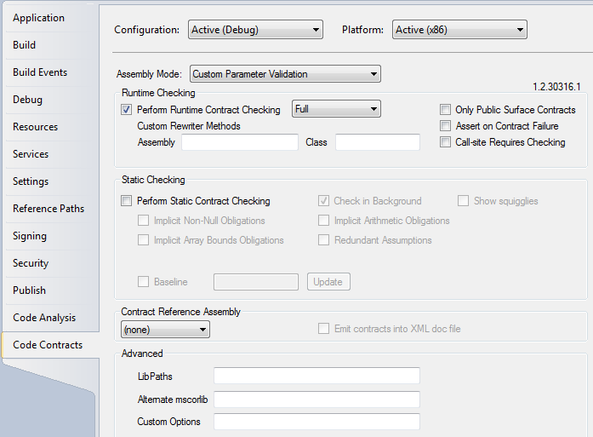
Code Contracts
Authoring of Contracts
Build scripts
Rewriter
Contract Reference Assemblies
Property Pane
Contract XML Docs
Contract Visualization
Static Checker

Slide 16
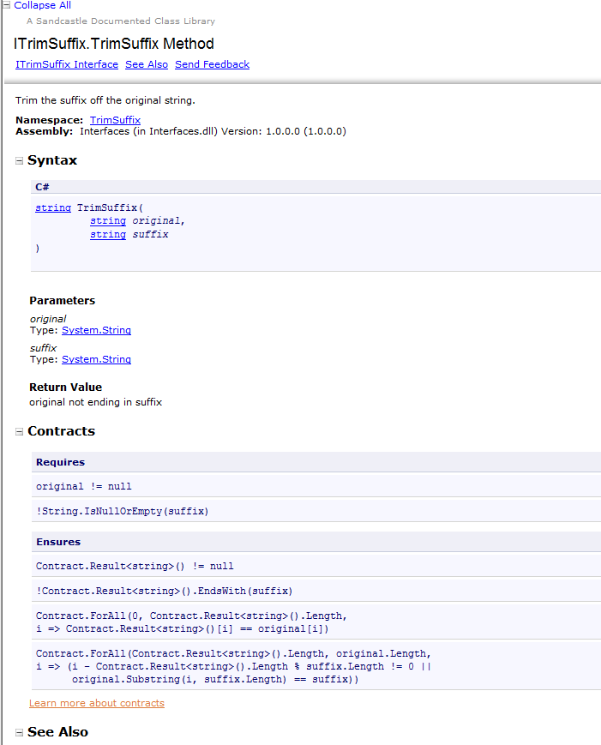
Code Contracts
Authoring of Contracts
Build scripts
Rewriter
Contract Reference Assemblies
Property Pane
Contract XML Docs
Contract Visualization
Static Checker

Slide 17
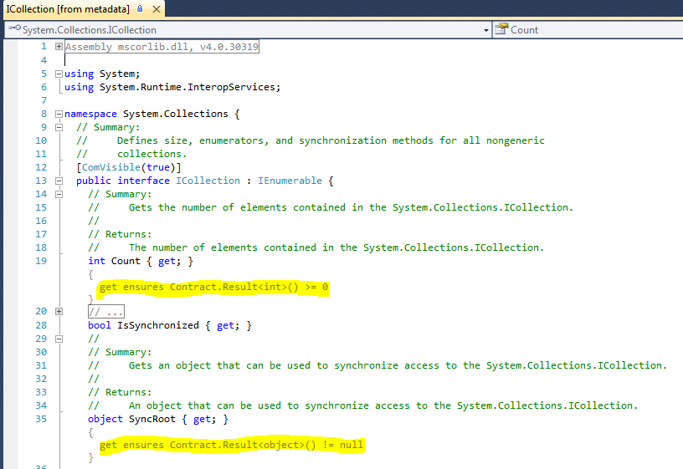
Code Contracts
Authoring of Contracts
Build scripts
Rewriter
Contract Reference Assemblies
Property Pane
Contract XML Docs
Contract Visualization
Static Checker

Slide 18
Code Contracts
today
Authoring of Contracts
Build scripts
Rewriter
Contract Reference Assemblies
Property Pane
Contract XML Docs
Contract Visualization
Static Checker
BCL owns
Research owns

Slide 19
Code Contracts
possible future
Authoring of Contracts
Build scripts
Rewriter
Contract Reference Assemblies
Property Pane
Contract XML Docs
Contract Visualization
Static Checker
BCL owns
Visual Studio owns
Research owns

Slide 20
Value Propositions for CLR
Consistency checking among frameworks (desktop, silverlight, compact, phone, …)
Work item: annotate public APIs with more contracts
Benefit: Discover platform inconsistencies early
Additional benefit: Increase customer satisfaction
More precise documentation
Contract tools work better
Optimizing parameter validations
Concerted effort to reduce redundant validations
Unsafe code verification
Check memory safety of critical unsafe code

Slide 21
We Need a Ship Vehicle
MSR does not want to continue owning all the tools.
Should tools ship in the Windows Platform SDK, VS, CodePlex, DevLabs, or an MSR site?
Currently: On DevLabs
Recommendation: Ship all tools in the Windows Platform SDK
What license restrictions?
Currently: static checker only available to VS Premium users
Recommendation: Review this w/ business leaders
Ownership of tools
VS Static Analysis team may be interested in the static analyzer, but isn’t resourced to own it right now
Code contract binary rewriter is currently owned by MSR. Could be owned by CLR
Contract reference assemblies owned by .NET FX teams
Shipped in .NET Framework Multitargeting packs for VS?

Slide 22
More Depth - Feature Work
.NET Framework needs more preconditions & postconditions
Need to increase internal adoption by .NET FX teams
Tool to identify legacy preconditions
Postconditions added in high-value areas
BCL & MSR collaborate on deeper representation
Threading issues
Model variables
Building blocks for future innovation

Slide 23
Dev11 Development Tasks
Find new home for tools [P0]
2 weeks
CCRewrite to be ported to CCI 2 [P1]
n weeks, done by MSR
Productizing CCRewrite [P1]
3 weeks test, 2 weeks dev
MSR shifts to shipping contracts from product code [P1]
Could be driven from either CSDecl or retail binaries
1 week of plumbing, plus 1-2 weeks of copying contracts
CLR adds code contracts to portable library subset [P2]
Contract types should be added to .NET CF
2 weeks, not scheduled
BCL will need to add some postconditions [P2]
1-2 weeks

Slide 24
Questions?
codconfb@microsoft.com

Slide 25
Appendix

Slide 26
.NET FX Problem: Cross-SKU Compatibility
.NET FX has multiple implementations
No compatibility guarantee today across versions
Implementations up-stack may live in two different source trees, and in different files
NCL has two SL + one desktop implementations
Solution: Compare preconditions & postconditions across profiles
Can instrument SL implementations with contracts, then run existing tests to look for behavioral differences
Needs a source of contracts, such as Dev11 sources, MSR contracts, or potentially Portable Library Subset
Needs some tooling

Slide 27
Future Research & Development
Threading [Dev11?]
Some Postconditions are only valid if evaluated under locks
Monitor.IsLockHeld(this) => (this.Count == Contract.OldValue(this.Count) + 1)
Unsafe code [Dev11?]
Code contracts can be a managed SAL
Working prototype for over a year – need some methods in the BCL & some thorough practical experience

Slide 28
Future Research & Development Ideas
Model variables [Dev11?]
No predicate for whether an instance has been disposed
Tracking a method’s thrown exceptions [Dev11?]
Contract.Throws<ArgumentException>()
For documentation purposes - not all of Java’s checked exceptions model
Language integration (syntactic sugar) [Dev12]
FxCop rules to suggest preconditions & postconditions [Dev11?]
FxCop rules to identify internal classes that look like Code Contracts, and tell them to use ours (to improve performance, reduce complexity and working set) [Dev11?]
Rico Mariani’s Performance Categories idea [??]
Notes:
http://research.microsoft.com/en-us/projects/pex/

Slide 29
Code Contracts Details
Runtime checking – Asserts on steroids
Applies to subclasses & interfaces
Value proportional to your code coverage
Static checking – Finds bugs at build time
Bugs are much cheaper to find
Value proportional to quality of library annotations and our static checker
Consists of:
Preconditions & postconditions at method boundaries
Assertions and assumptions within method bodies
Representation of return values & “old” values of properties
Quantifiers: Contract.ForAll(0, array.Length, i => array[i] != null);
Contracts on interfaces & abstract base classes

Slide 30
Productizing the Tools
Finding a non-DevLabs ship vehicle is Pri0 for Dev11
CodePlex, .NET Framework SDK, VS Static Analysis team
Testing - Tools have been used by many teams, but not formally tested
Vipul did some usage testing
Roundtripping binaries through CCI 2 unveiled numerous issues in Dev10, and the CLR Test Team contributed significantly
CCRewrite runs every day on checked & debug builds of some of our bigger libraries
Localization
CCRewrite currently depends on CCI 1
CCI 2 is better tested. CLR team has higher confidence in CCI 2

Slide 31
Tools Available on DevLabs
CCRewrite – binary rewriter
CCCheck – static checker, for premium clients
CCRefGen – Contracts reference assembly generator
CCDocGen – documentation generator
Sandcastle style sheets to display code contracts
Visual Studio Add-In
Tab in project settings
Shortcuts for typing contracts in source
Size of tools: 325 kb
Notes:
From Mike Barnett: CCDocGen only enriches the xml file produced by the compiler (it creates one if there isn’t already one there). So the xml file contains new tags like <requires>. Then separate from that are some modified Sandcastle style sheets. If you replace the standard style sheets in Sandcastle with the modified ones and then run Sandcastle on the enriched xml files, you’ll get help files that look like MSDN pages but with contract sections.
Sandcastle is available on Codeplex, but I think only as binaries. Their style sheets are part of their distribution and so are also public (and free). The modified style sheets come in *our* distribution. I’ve repeatedly tried to get in touch with the Sandcastle people to see if they want to ship our style sheets as theirs, but they never answer my mail.

Slide 32
If we don’t invest any more…
From Wolfram Schulte:
we make all tools available free for commercial use as part of a CodePlex download – it doesn’t make sense to keep the project in-house if here is real demand.

Slide 33
Future Research & Development
Just one possibility… Integration with CSDecl
Specify behavior in one spot, for verification and/or injection into all .NET Framework profiles & flavors
Reference assemblies are generated from CSDecl ➔ they become the official distribution mechanism for code contracts
Source
Code
Assembly without contracts
Retail binary
Compile source w/ CSC
Compile CSDecl files w/ CSC.
3) Rewrite retail binary to include code contracts from the reference assemblies
CSDecl
File with Contracts
Reference Assembly with Contracts
Notes:
Another more incremental option:
Build CSDecl files with one set of #defines to get reference assemblies as-is today.
Build CSDecl files with a second set of #defines to generate contract reference assemblies.
Plus: Gives a more incremental approach. Does put code contracts in the Framework, owned by the Framework teams.
Minus: Still shipping two files, and need a ship vehicle for contract reference assemblies.

Slide 34
Ancillary Benefits
Advanced our confidence in CCI
Allowed us to build other managed tools quickly
RefAsmGen, Shrink, some targeted patching work
Testing round tripping through CCI 2 improved the infrastructure for all of these tools

